Slide 1
Data Structures and Algorithms
CSC206
Unit 3:Recursion
Shyam Sunder Khatiwada

Slide 2
Recursion
Recursion is a process by which a function calls itself repeatedly, until some specified condition has been satisfied.
Powerful technique of writing a complicated algorithm in an easy way.
The process is used for repetitive computations in which action is stated in terms of a previous result.
In order to solve a problem recursively, two conditions must be satisfied:
First, base condition should be defined (stopping condition).
Second, Changing state of recursive call moving towards the base condition.
We use recursion to solve bigger problem

Slide 3
Recursion
Problem is defined in terms of itself.
When a complex problem can be broken down into smaller, identical problems.
Searching for a file on computer.
To search in top directory we must also search in all the subdirectories and so on.
Note:
A recursive function is a function which call itself.
Beware: Just like while loops, this means we have the risk of code never ending.
A recursive program must change its state so that it moves towards the base case.
Otherwise it will never stop.

Slide 4
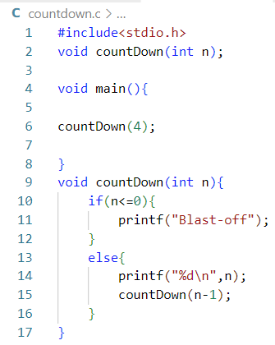
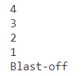
Example
Output:

Slide 5
Recursion: Disadvantage
Can be hard to debug.
are slower than non- recursive functions.
is usually less efficient than iteration in terms of the amount of memory required.
It is difficult to think recursively so one must be very careful when writing recursive functions.

Slide 6
Recursion: Advantage
The code may be much quicker and shorter to write.
Much easier to write and read.
Many things are “naturally recursive”.

Slide 7
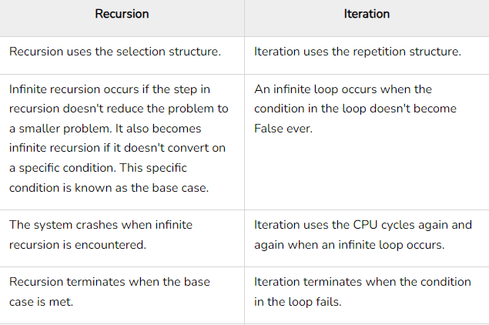
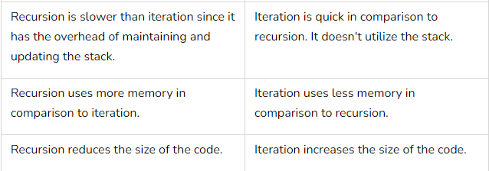
Comparison between Recursion and Iteration

Slide 8
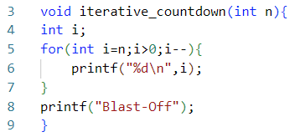
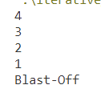
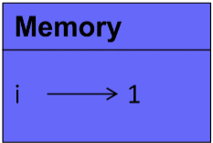
Iterative approach and memory

Slide 9
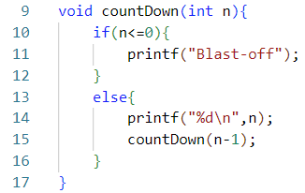
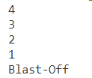
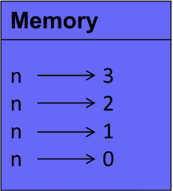
Recursive approach and memory:

Slide 10
Application of Recursion
Solving tree structure algorithm
Calculating mathematical series
Drawing fractals
Sorting data

Slide 11
Tail Recursion
A special form of recursion where the last operation of a function is a recursive call.
If a function is calling itself and that recursive call is the last statement in a function then it is called tail recursion.
After that call there is nothing, it is not performing anything, so it is called tail recursion.
The tail recursive functions considered better than non tial recursive functions as tail-recursion can be optimized by compiler.

Slide 12
Tail Recursion:
Compilers usually execute recursive procedure/functions by using a stack.
This stack consists of all the pertinent information, including the parameter values, for each recursive call.
when a procedure/function is called, its function is pushed onto a stack, and when the function terminates the information is popped out of the stack.
Thus, for the non-tail recursive functions, the stack depth (maximum amount of stack space used at any time during compilation) is more.
The idea used by compilers to optimize tail-recursive functions is simple, since the recursive call is the last statement, there is nothing left to do in the current function, so saving the current function’s stack frame is of no use.

Slide 13
Example: Tail Recursion
#include <stdio.h>
void fun(int n)
{
if (n > 0)
{
printf("%d", n);
fun(n-1);
}
}
int main ()
{
fun(3);
return 0;
}
The following is an example of tail recursion.
There is no any operation after the recursive call and that recursive function call is the last statement.

Slide 14
Example: Not Tail Recursion
#include <stdio.h>
void fun(int n)
{
if (n > 0)
{
printf("%d", n);
fun(n-1) + n;
}
}
int main ()
{
fun(3);
return 0;
}
As you can see in the example,
there is something written (+n) along with the function call i.e. some operation is going to be performed at returning time and hence cannot be tial recursion.
Tail recursion means at returning time it doesn’t have to perform anything at all.

Slide 15
Tail Recursion: Factorial
long int multiplyNumbers(int n) {
if (n<=1)
return 1;
else
return n*multiplyNumbers(n-1);
}
int factorial( int n, int fact )
{
if ( n==1 )
return fact;
else
factorial( n-1, n*fact );
}
We can make it tail recursive, by adding some other parameters.
This example is not a tail recursion.

Slide 16
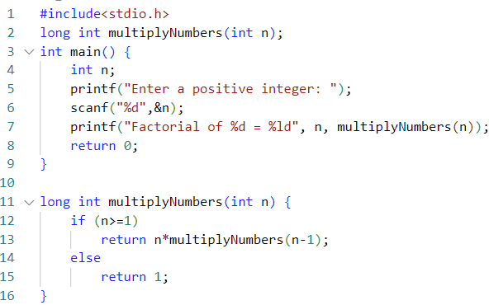
Recursion: Factorial
GitHub Link:
Click- Recusive Factorial

Slide 17
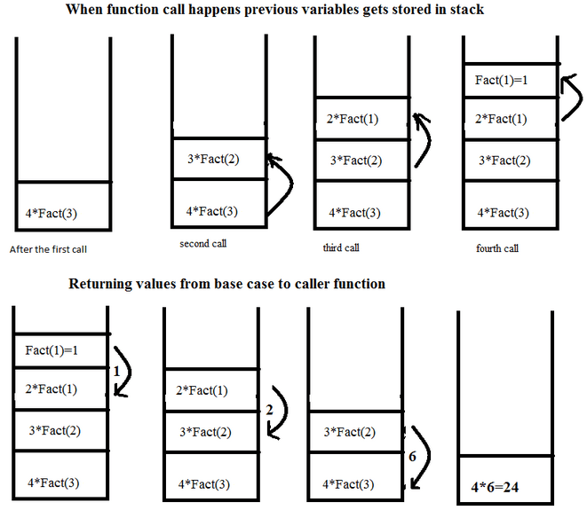
Recursion: Factorial→ working stack

Slide 18
Recursion: Fibonacci Sequence
The Fibonacci Sequence is the series of numbers:
0, 1, 1, 2, 3, 5, 8, 13, 21, 34, ...
The next number is found by adding up the two numbers before it:
the 2 is found by adding the two numbers before it (1+1),
the 3 is found by adding the two numbers before it (1+2),
the 5 is (2+3),
and so on!

Slide 19
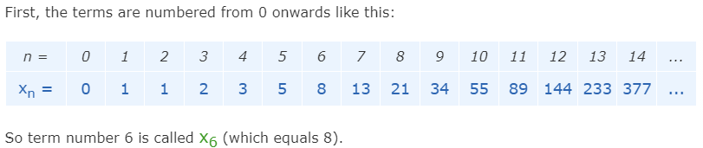

Recursion: Fibonacci Sequence : Rule
The Fibonacci Sequence can be written as a "Rule"

Slide 20
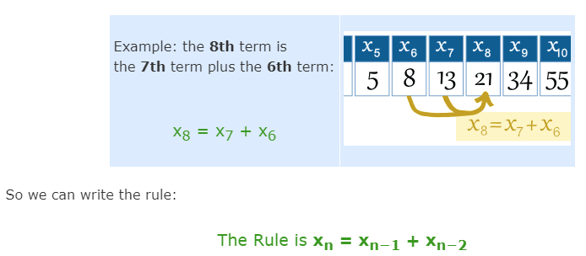
Recursion: Fibonacci Sequence : Rule

Slide 21
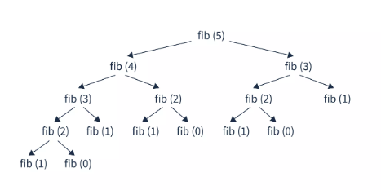
Recursion: Fibonacci Sequence: How it works

Slide 22
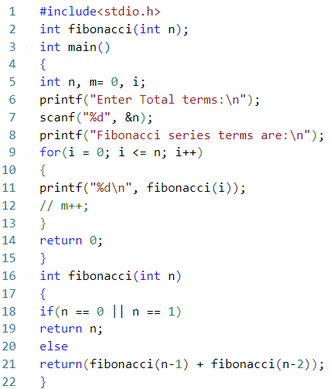
Recursion: Fibonacci sequence: Implementation
GitHub Link:
Click here --> Fibonacci Sequence using recursion

Slide 23
Recursion: GCD
GCD (Greatest Common Divisor) or HCF (Highest Common Factor) of two numbers is the largest number that divides both of them.
For example: let’s say we have following two numbers: 63 and 42
63 = 7 * 3 * 3
42 = 7 * 3 * 2
So, the GCD of 63 and 42 is 21.

Slide 24
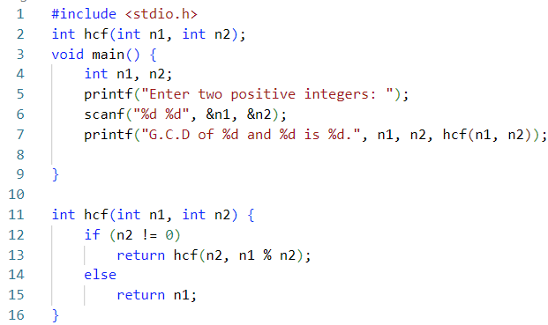
Recursion: GCD : Implementation
GitHub Link:
Click Here --> GCD using recursion

Slide 25
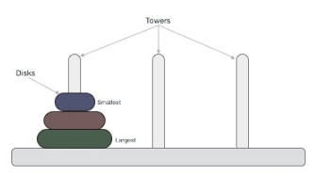
Recursion: Tower of Hanoi
The Tower of Hanoi is also known as the Tower of Brahma or the Lucas Tower. It is a mathematical game or puzzle that consists of three rods with ’n’ number of disks of different diameters.
The objective of the game is to shift the entire stack of disks from one rod to another rod following these three rules :
Only one disk can be moved at a time.
Only the uppermost disk from one stack can be moved on to the top of another stack or an empty rod.
Larger disks cannot be placed on the top of smaller disks.

Slide 26
Recursion: Tower of Hanoi
Algorithm:
Step 1: Start the program.
Step 2: Input number of disks.
Step 3: Declare a function which takes the number of disks, starting disk, auxiliary disk and final disk as argument and recursively calls itself twice.
Step 4: Call the function.
Step 5: End the Program.

Slide 27
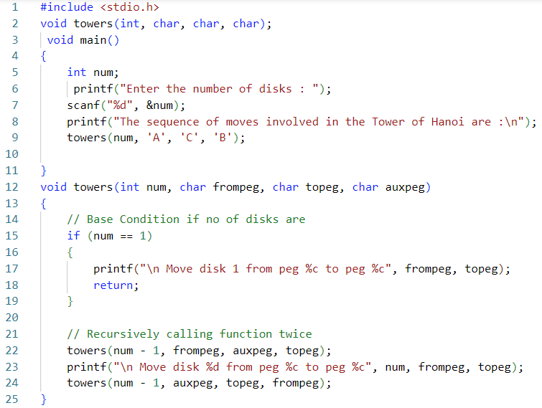
Recursion: Tower of Hanoi: Implementation
GitHub Link:
Click Here: Tower of Hanoi

Slide 28
WorkOut:
Write a program of factorial, fibonacci sequence, GCD and tower of hanoi using function but not recursive.
Solve the question a using recursive.

Slide 29
Any Query?
Thank You!!!!

